Slide 1
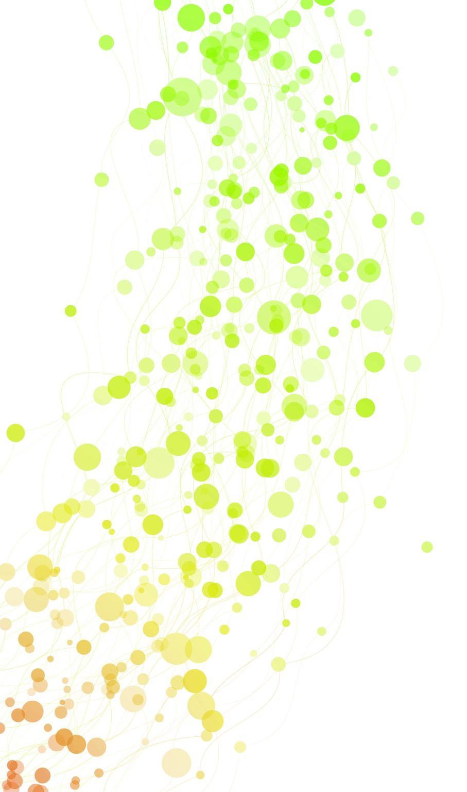
Proteome-wide Screen for RNA-dependent Proteins- non-synchronized A549 cells
Project Proposal
Anastasia Möller, Johannes Schadt, Sylviane Verschaeve, Tine Limberg

Slide 2

`We can only start to imagine the many opportunities that lie ahead´
F. Gebauer et. al (2020). RNA-binding proteins in human genetic disease

Slide 3
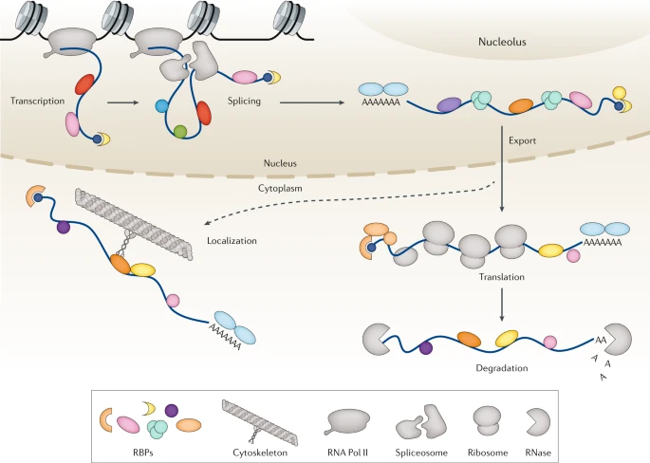
RNA-binding proteins (RBP)
RBP family is one of the largest in the cell
>4000 RBPs are already found
Control RNA life, function, efficiency -> house-keeping role
Extensive regulatory networks
F. Gebauer et. al (2020). RNA-binding proteins in human genetic disease
Notes:
Regulate transcription, splicing, modification, intracellular trafficking, translation, decay
RNA regulates also activity of RBPs

Slide 4
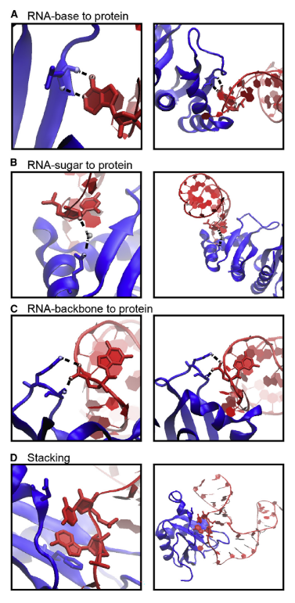
RBP interaction with RNA
Binding through hydrogen bonds & Van der Waals interactions
Interactions occur dynamically -> local rearrangements
4 typical types of interactions
Often RBPs have RNA binding domains
Combining multiple RNA binding domains in one RBP -> high specificity
Notes:
! Proteine, die andere Proteine dazu befähigen an RNA zu binden erwähnen

Slide 5
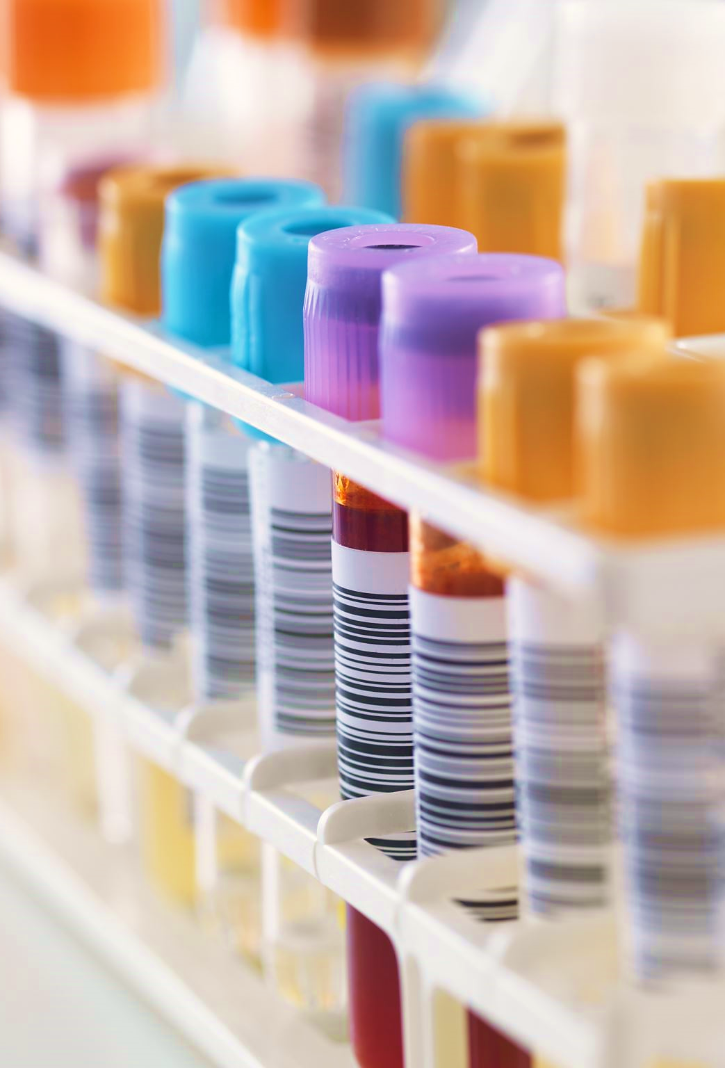
RBP related diseases
Mutations in RBP encoding genes
Malfunction underlies origin of many diseases
Tissue specific defects
-> Diseases of nervous system
-> cancer cells
Promising novel therapeutic targets
Notes:
Mutations alter RBP expression levels, truncate protein or change aminoacids (interaction with cofactors, RNA or metabolites are prevented or altered), affect (enzymatic) properties of RBPs
Nearly 1/3 of RBPs may be mutated in diseases -> already more than 1000 disease related RBPs
In mendelian disorders RBPs outnumber transcriptionfactors and other proteins regarding the prevalence of mutations
Tissue specific: because of tissue specific expression, RBPs specific because of post translational modifications
Further work is required to resolve role of RBPs in translational control and therefore in diseases

Slide 6
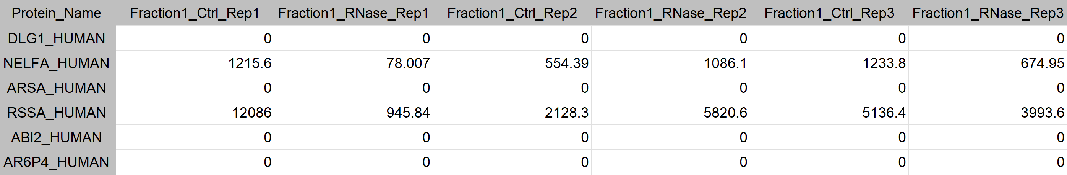
DATASET: Mass Spectrometry Data
Amount of NELFA_HUMAN
Fraction 1
Replicate 2
Control sample
150 columns
25 Fractions
3 Replicates – Control sample
3 Replicates – RNase sample
3680 rows
= proteins
Notes:
3680

Slide 7
TIMELINE
Milestone 1
Preparing dataset for analysis
1st
2nd
3rd
4th
5th
6th
7th
8th
9th
Notes:
Milestone

Slide 8
1st week
1st week
2nd
3rd
4th
5th
6th
7th
8th
9th
1st
Milestone 1
Preparing dataset
for analysis

Slide 9
1st week
1st week
Milestone 1
Preparing dataset
for analysis

Slide 10
1st week
-> preparing data for analysis
Description
Defining data type
Connection between data and the biology behind it
Data cleanup
Making sure all data is numeric
Setting zero to NA (to calculate mean and correlation)
Reproducibility
Correlation -> what should we do if they do not correlate -> t.test with 0.05 p-value => if failed, then discard
Connection between data and the biology behind it
Removing outlier samples
Re-ordering rows/columns in meaningful and useful ways
Notes:
change class to numeric
analysis of zero’s
normalization protein quantity
deepen biological background and research of biological question
prepare dataset for analysis
better understanding of biological question

Slide 11
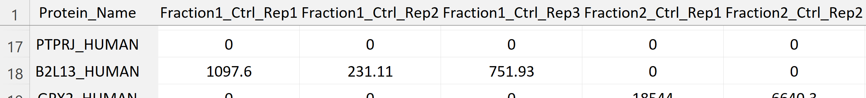
1st week
1) Reordering columns: controls followed by RNAse
2) Reproducibility: calculating the correlation between each replicate (total 6); if t-test fails, discard protein
Tabelle, welche Werte
Notes:
We aim to normalize our data by computing the mean of all fractions for every replicate for each protein. Out of the means calculated we choose the two reps with the smallest difference of their means. We use these 2 reps to compute the mean for one fraction and create a new matrix.
Tabelle, welche Werte

Slide 12
TIMELINE
Milestone
Preparing dataset for analysis
1st
2nd
3rd
4th
5th
6th
7th
8th
9th
Milestone
data reduction
Notes:
Milestone

Slide 13
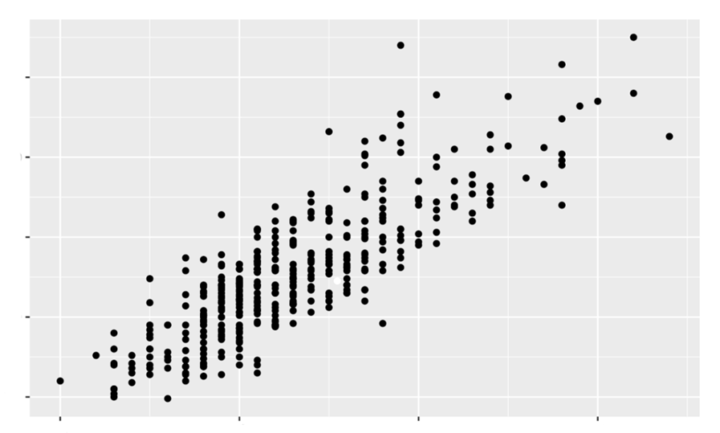
2nd week
1) Mean value methode: mean for each replicate over all fractions
Mean of replicate 1
Mean of replicate 2
Smallest difference
Calculate mean
Mean of replicate 3
2) Normalization: to value 1
3) Descriptive Statistics: QQ-plot with mean of fraction of DNAse & Control
High correlation
High correlation means not RNA binding protein
RNA binding protein = ?
Control
DNAse
Notes:
Normalization of protein amount
Normalization between replicates (mean value method)
Correlation between proteins (->dimension reduction) (PCA, k-means, silhouette method)
Merge highly correlating proteins (name = name of merged proteins)

Slide 14
TIMELINE
Milestone
Milestone
Make data steady
1st
2nd
3rd
4th
5th
6th
7th
8th
9th
Milestone
Notes:
Milestone

Slide 15
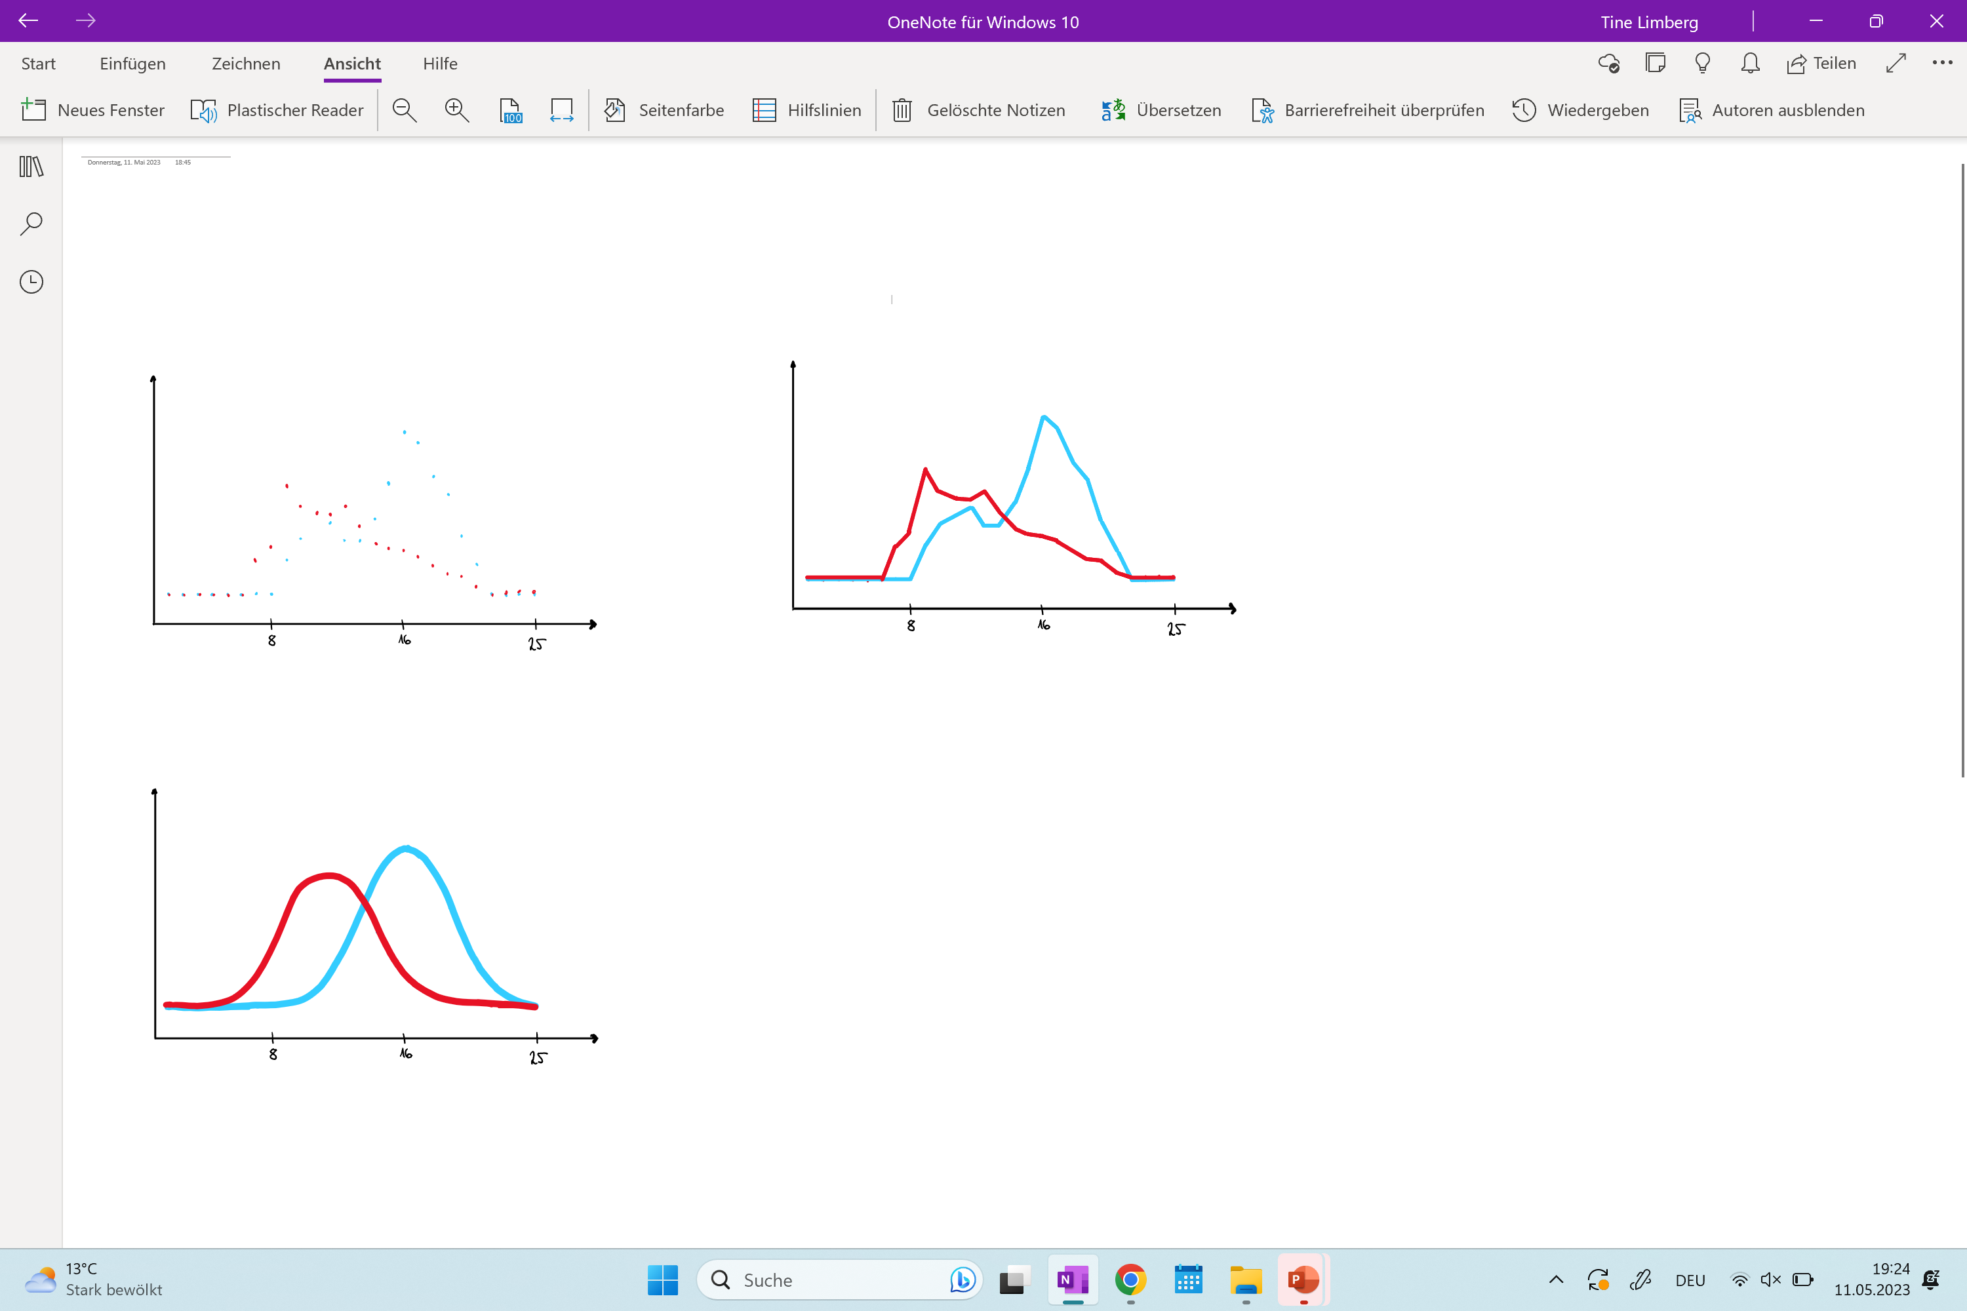
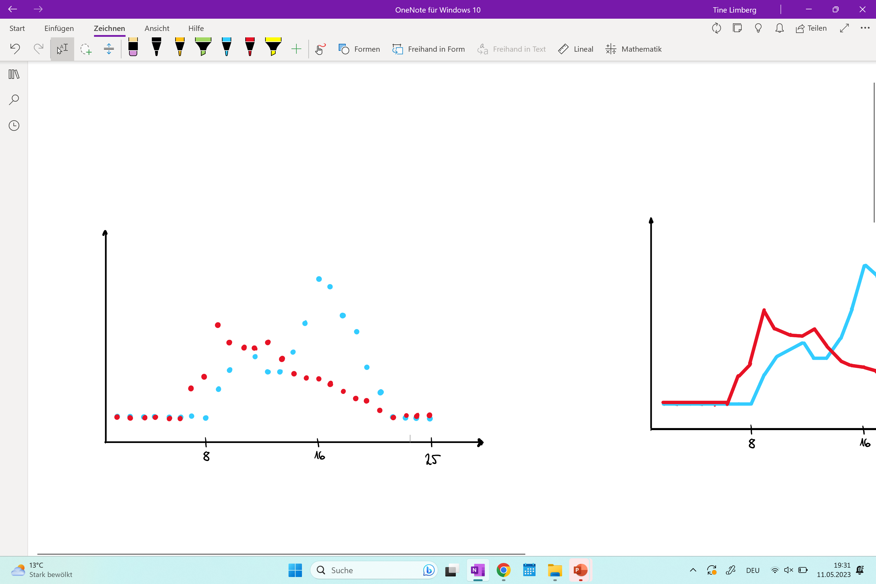
3rd week
1a) Creating line graph: 1b) Identify global and local maxima:
discrete values to continuous values which area should we include
RNase
Control
Proteine amount
Proteine amount
Fraction
Fraction
2) Gaussian fit: over each curve (representing a protein)
Proteine amount
Fraction
Notes:
identifying local maxima
Add shoulder regions
Fitting gaussian curves

Slide 16
TIMELINE
Milestone
Milestone
1st
2nd
3rd
4th
5th
6th
7th
8th
9th
Milestone
Milestone
Identification of RBPs
Notes:
Milestone

Slide 17
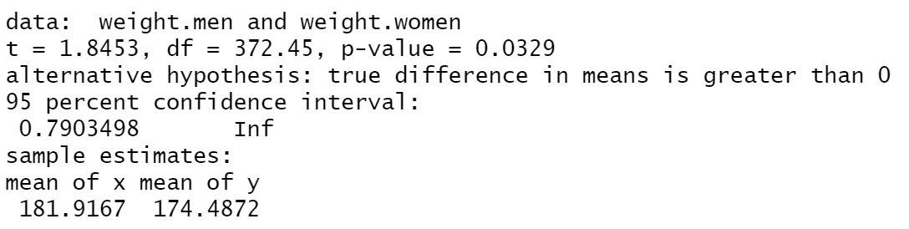
4th week
1) Significance of shift: identify whether the shift is significant -> if yes, then RNA binding protein
RNase
Control
?
Small samples:
if shift between 1 to 3 fractions is significant
Question: what about partial shift?
Proteine amount
Fraction
2) Test significance for all proteins: T-test between RNase and Control for each protein
RNase
Control
Small samples:
Decide, which p-value
means significant
Notes:
Plotting shift between control and RNase sample
Selection of significant shifts (p-value tests)
Comparing to protein databases

Slide 18
TIMELINE
Milestone
Milestone
Milestone
1st
2nd
3rd
4th
5th
6th
7th
8th
9th
Milestone
Milestone
Notes:
Milestone

Slide 19
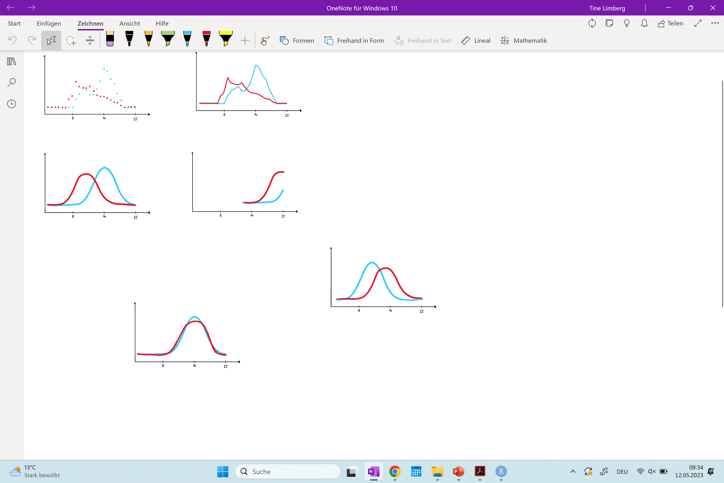
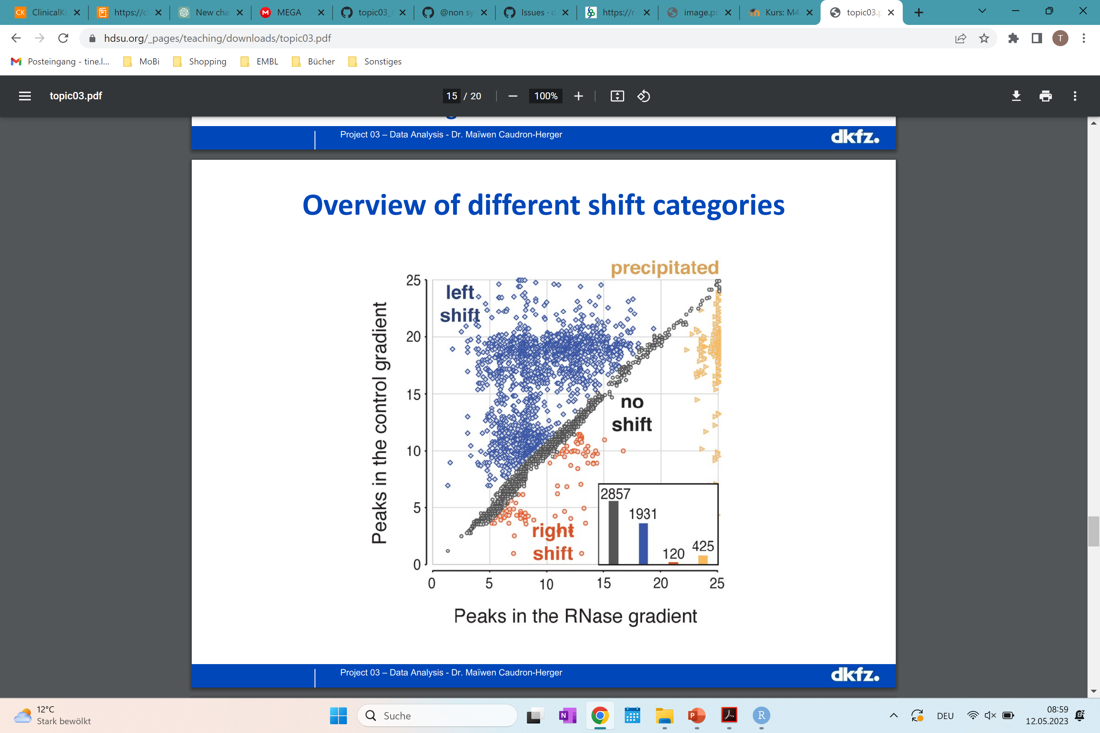
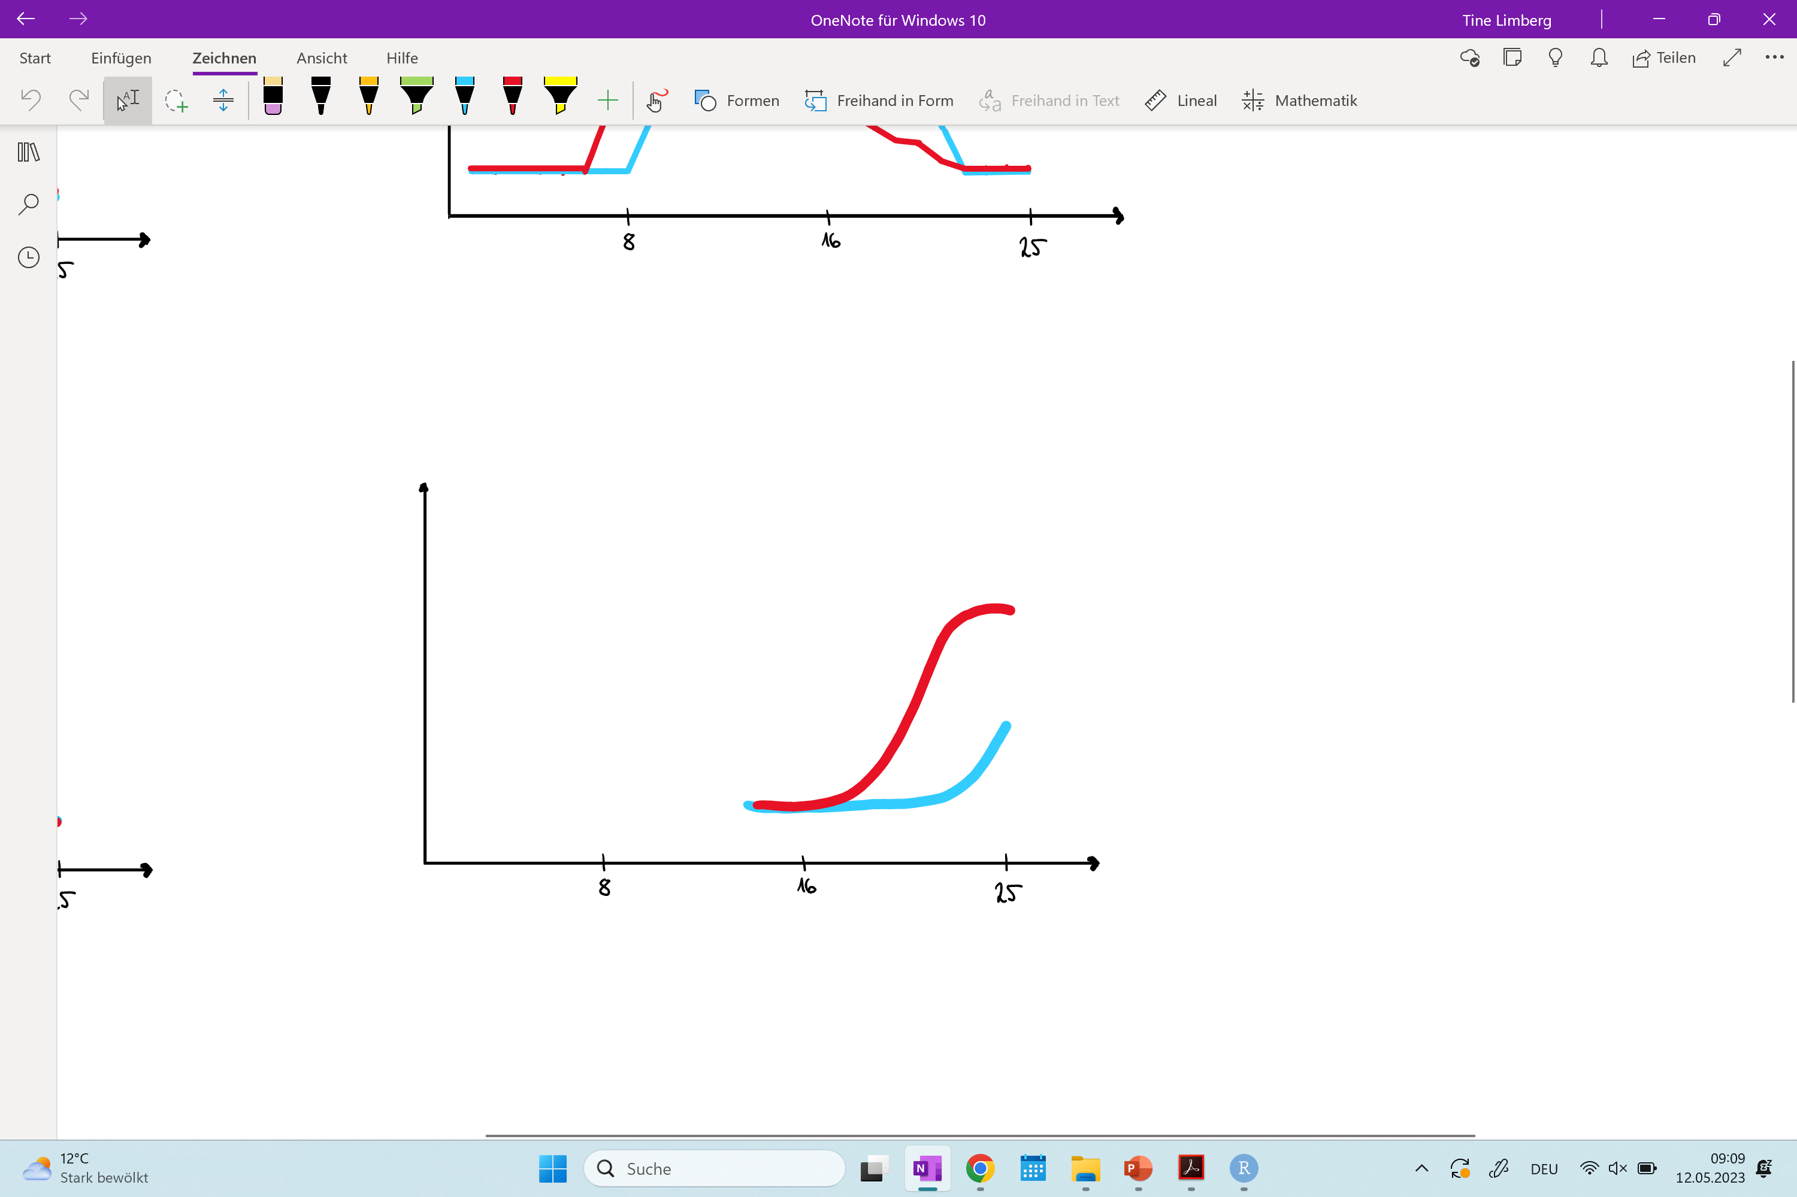
5th week
1) Clustering the graphs: k-means with following graphs: left shift, right shift, no shift, precipitated
Left shift
Right shift
RNase
Control
Proteine amount
Proteine amount
Fraction
Fraction
No shift
Precipitated
Proteine amount
Proteine amount
Fraction
Fraction
Notes:
Defining shifts in left and right shift
Comparison to databases (20 example proteins)
Plot overview of different shift categories

Slide 20
TIMELINE
Milestone
Milestone
Milestone
1st
2nd
3rd
4th
5th
6th
7th
8th
9th
Milestone
Milestone
Milestone
Notes:
Milestone

Slide 21
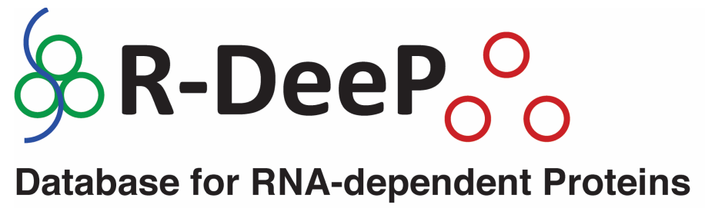
6th week
1) Regression Analysis: predict whether RNA binding protein based on the shift
Wie wollen wir das machen
2) Comparison: own data with online data bases
Notes:
Regression model
Connection between protein function and results (for specific examples)
Wie wollen wir das machen

Slide 22
TIMELINE
Milestone
Milestone
Milestone
Milestone
1st
2nd
3rd
4th
5th
6th
7th
8th
9th
Milestone
Milestone
Milestone
Notes:
Milestone

Slide 23
Notes:
Project report (pdf)
Final presentation

Slide 24
TIMELINE
Milestone
Milestone
Milestone
Milestone
1st
2nd
3rd
4th
5th
6th
7th
8th
9th
Milestone
Milestone
Milestone
Milestone
Notes:
Milestone

Slide 25
Buffer weeks

Slide 26
Disadvantages of the Method
Proteins with leak interaction (low abondents) can be missed
Can not assess RBP affinity and specifity -> has to examine each protein individuals (functional follow up experiments)

Slide 27
Team Organisation
at least one meeting per week
Meeting on Wednesday before tutorium
Presenting achievements of the last week
Collect questions for tutorium
Use GitHub for organisation

